Slide 1


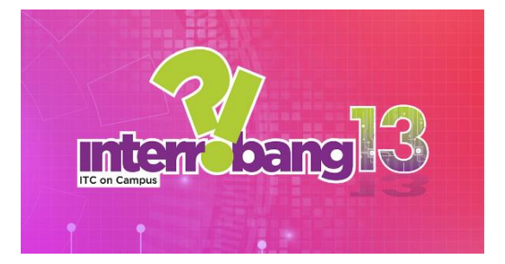
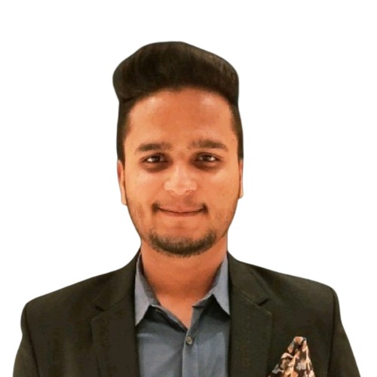
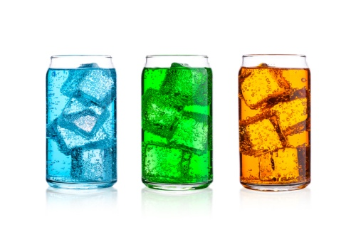


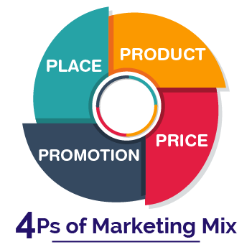
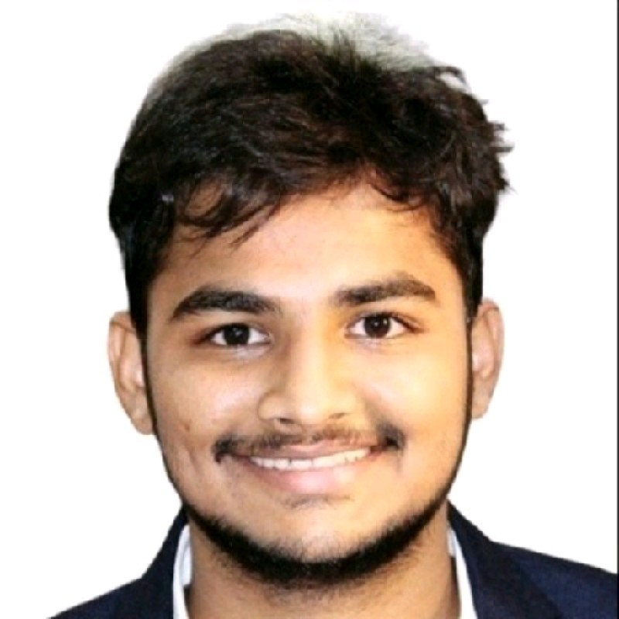
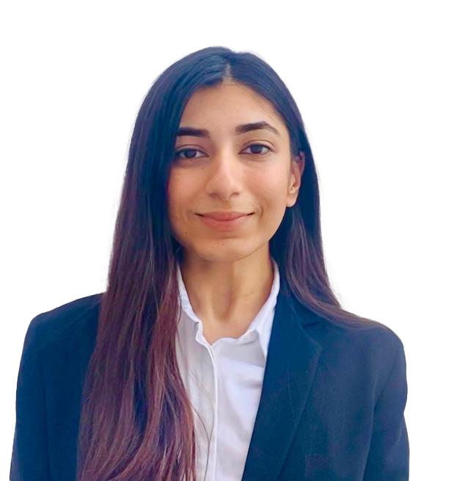




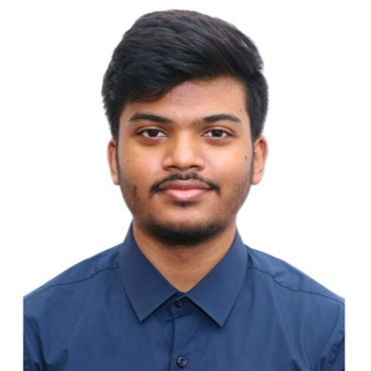

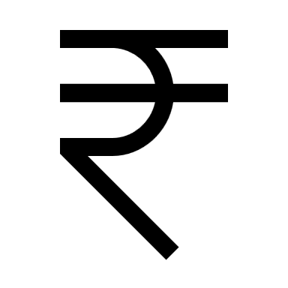


Team Bingo
Problem Statement
Missing
Differentiated Play
Feasibility
Marketing Mix
Name:- Keshav Lahoti
SAP ID:- 80512200463
Email:- keshav.lahoti463@nmims.edu.in
Name:- Bhagyesh Rajesh Jaju
SAP ID:- 80512200459
Email:- bhagyesh.jaju459@nmims.edu.in
Water and carbonation based beverage in ITC’s portfolio
In the Carbonated beverages industry to unlock the growth
Future of the sub-category and consumer acceptance
Of the sub-category based on actionable consumer insights
Our Approach
Evaluated 8+2 categories on various parameters, focused on differentiation.
Recommendation for product variants, value propositions, USP, ESP and packaging
Proposed strategy for different distribution channels and geographic regions
Cost structure and Revenue projection
Name:- Aditi Sharma
SAP ID:- 80512200511
Email:- aditi.sharma511@nmims.edu.in
SECONDARY
RESEARCH
PRODUCT
PLACE
FINANCIALS
PRIMARY
RESEARCH
PRICE
PROMOTION
TIMELINE &
MITIGATING RISKS
Name:- Vinamra Khaitan
SAP ID:- 80512200796
Email:- vinamra.khaitan796@nmims.edu.in
Estimated consumer preference and demand for identified category
Pricing strategy for different SKUs based on competitive landscape
Pre-launch buzz activities along with proposed campaign ideas for the main launch
Proposed timeline for final launch, possible risks and ways to mitigate

Slide 2

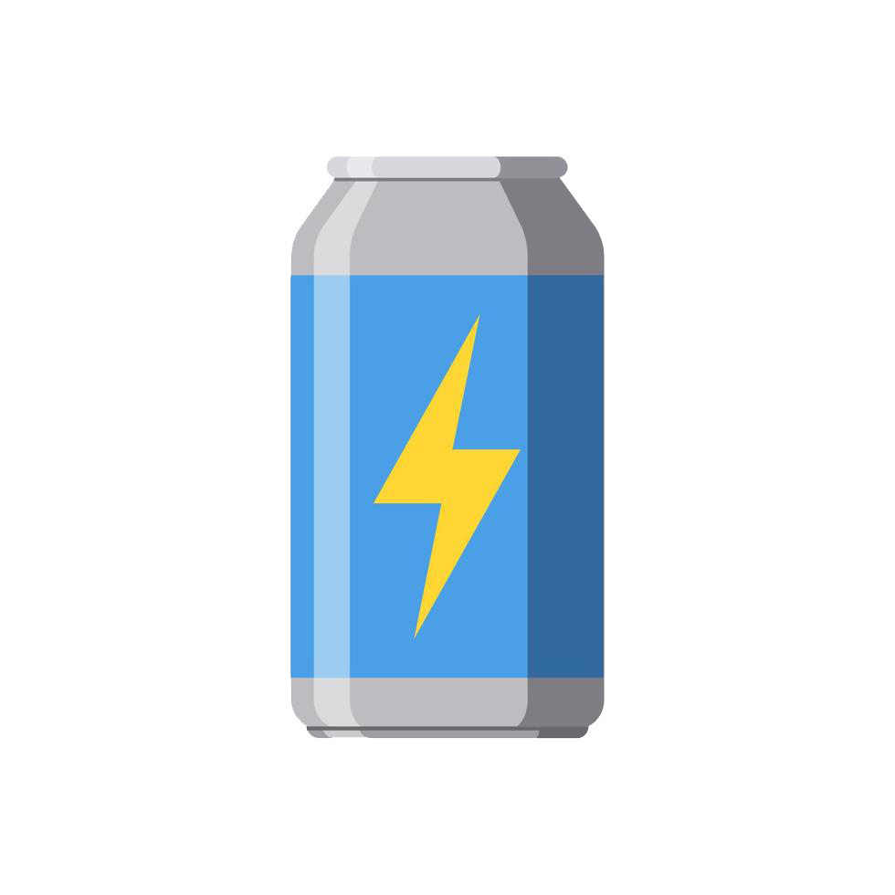
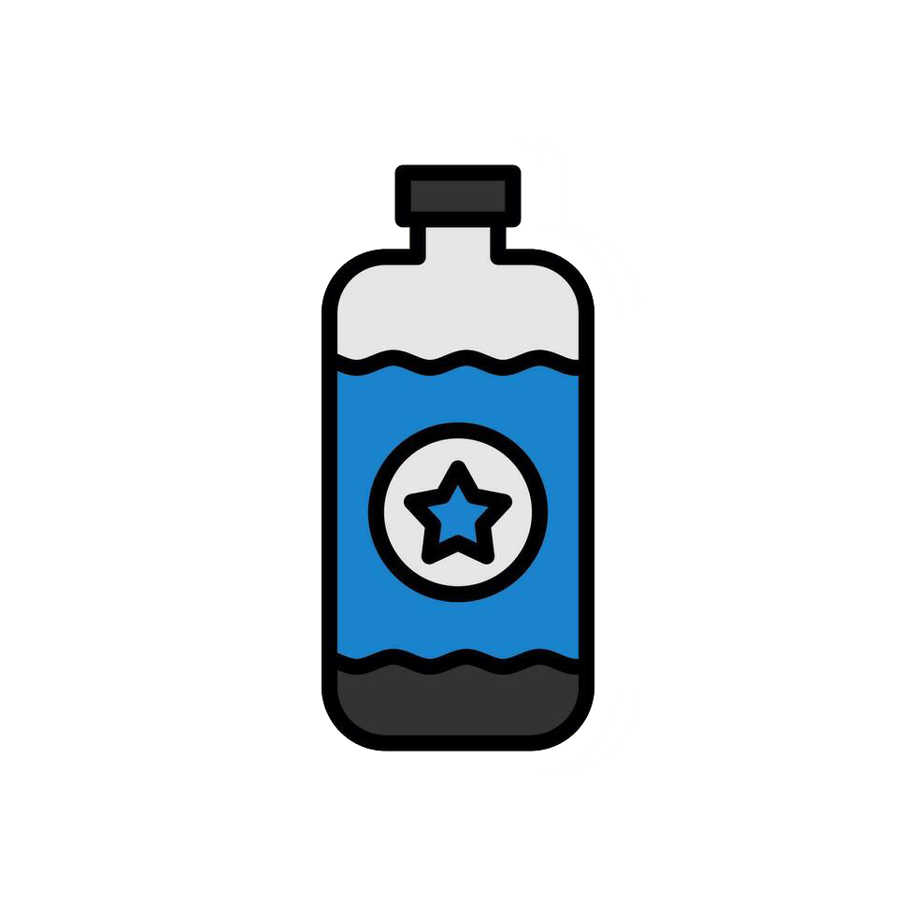
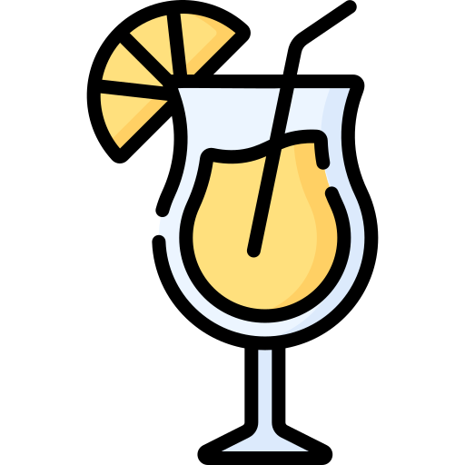
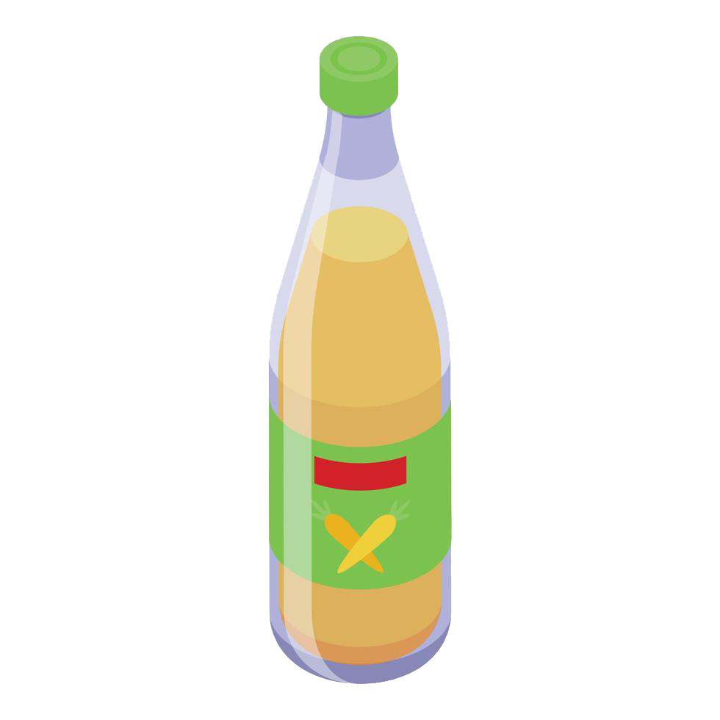
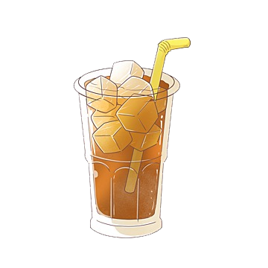
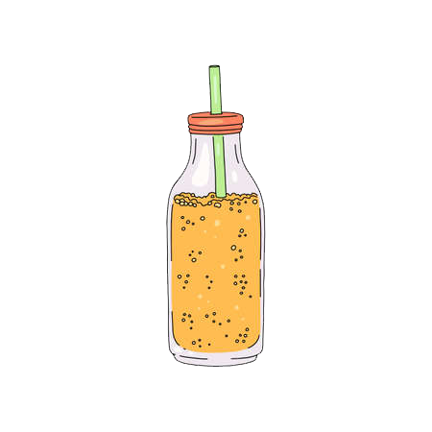

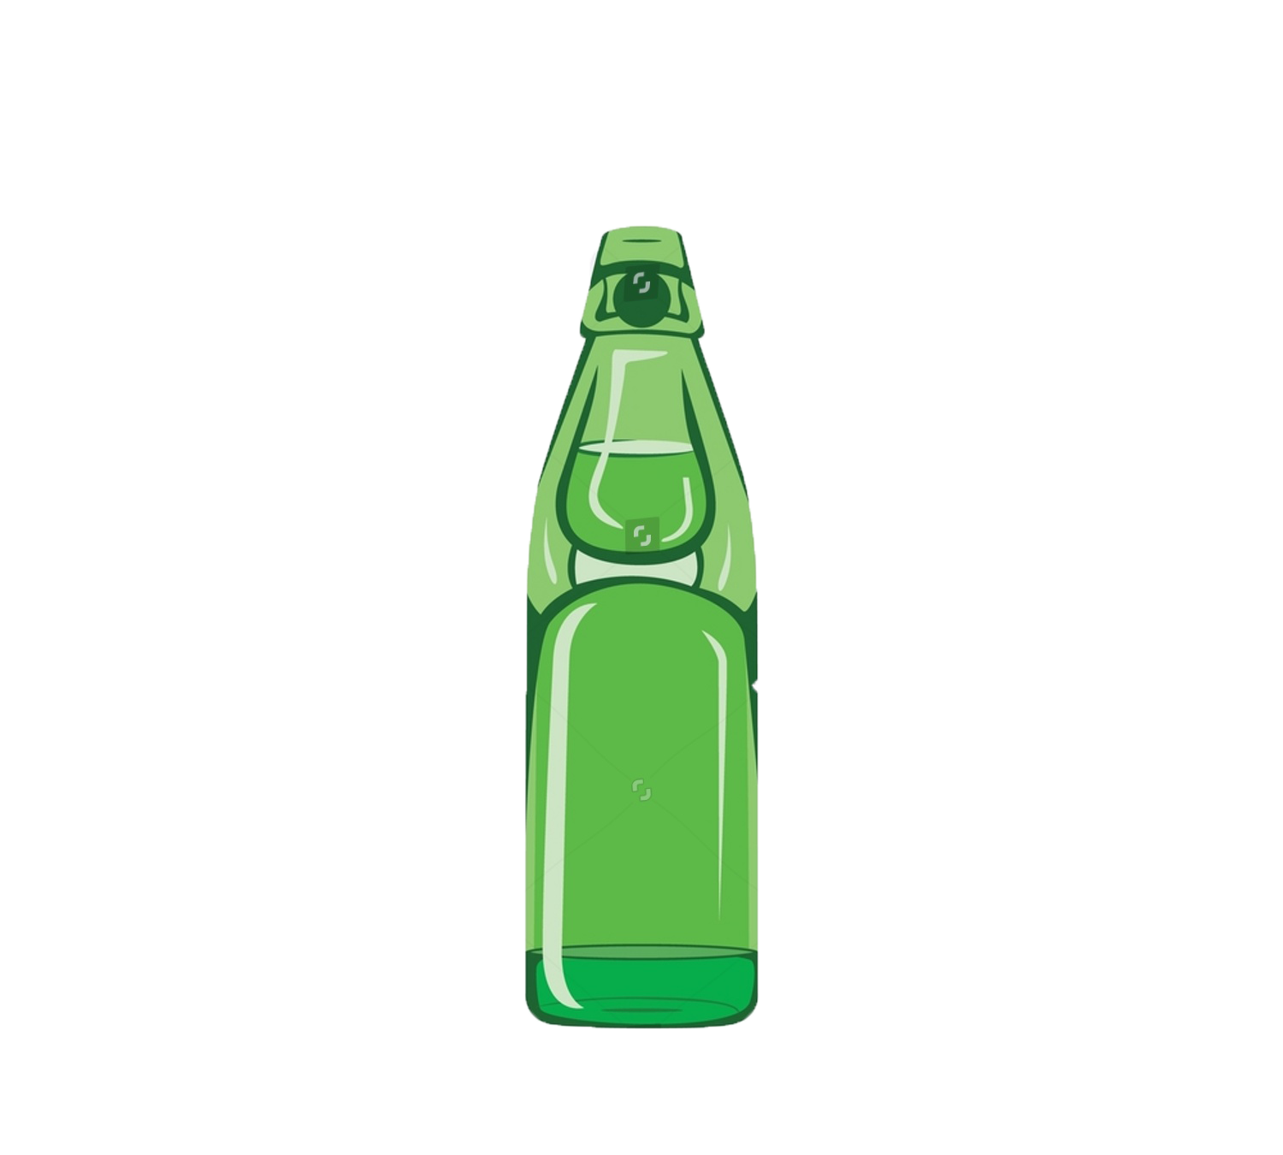


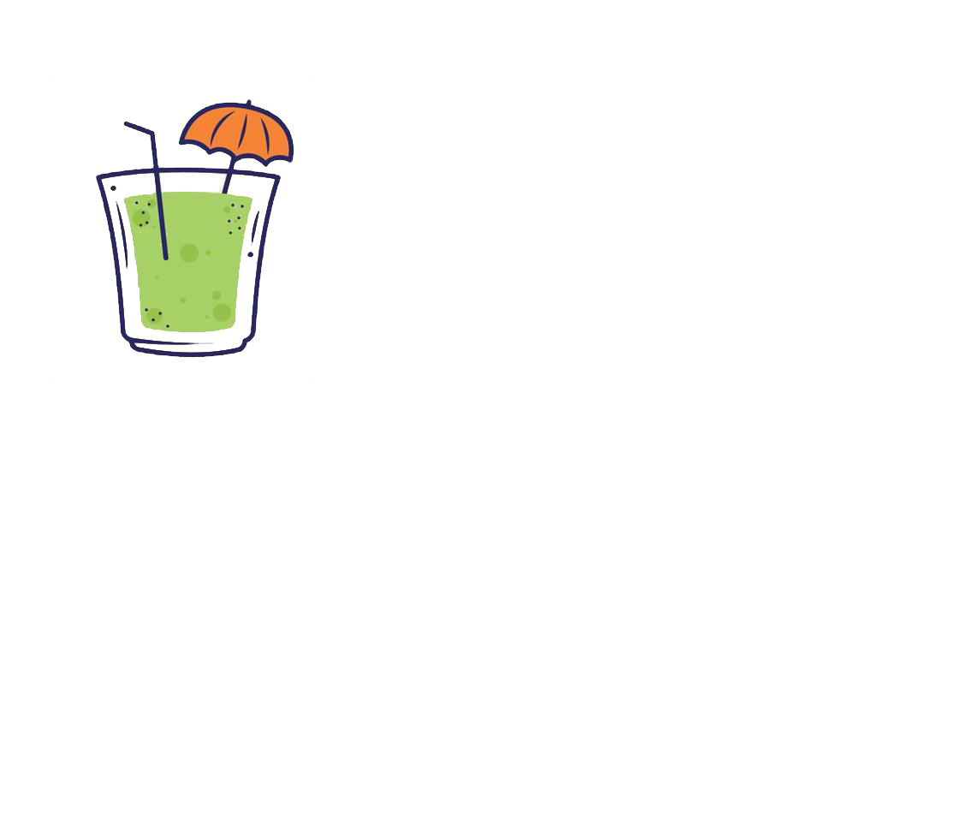

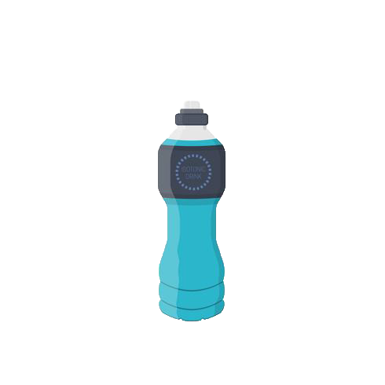

Sub-Category Evaluation
Market Estimation
Primary Research Findings
Product
Price & Place
Promotion & Timeline
Financials
Risks, Mitigation & Road Ahead
CATEGORY
PROS
CONS
OTHER CATEGORIES
Established market, potential for high margins if positioned well
Contain high levels of Sugar & Caffeine which may raise health concerns.
We explored two additional categories other than the given ones and obtained below insights based on our Primary Research.
Energy Drinks
Competition from bottled water and vitamin-enhanced beverages; may require substantial marketing efforts
Cocktails / Flavoured Soft Drinks
Consumer preferences indicate they're more suited for occasional consumption rather than daily use. E.g. Bisleri's Pinacolada launch failed
Fortified Water
Appeal to health-conscious consumers; potential for vitamin or mineral fortification
Versatile mixer for cocktails; ginger's perceived health benefits
Niche market; strong competition from well-established brands like Schweppes
Iced Tea
Booming category but requires cultural shift in consumers to consume tea in iced format. Cluttered market with players like Nestea, Lipton
Ginger Ale
Masala Drinks
Strong cultural resonance, readily accepted. They are also perceived to have health benefits and can also be launched in region specific variants
Flavor inconsistency, limited shelf life, and ingredient costs can pose challenges
LEVERAGING ITC’S STRENGTHS FOR MASALA DRINKS
The 100% Indian fruit factor of B Natural was very well accepted by consumers, the new sub-category would also be on similar lines
The 100% Indian fruit factor of B Natural was very well accepted by consumers, the new sub-category would also be on similar lines
Goli Soda
Unique traditional product, potential for nostalgia-driven sales in certain regions
Limited market reach compared to other categories; may not be as popular among younger consumers
Growing health-conscious consumer base, perceived as a healthier drink
Highly competitive market, limited differentiation opportunities, competition from established brands like SodaStream
Expertise in agricultural business with naturally sourced ingredients
Sparkling Water
Mixers
High demand in the hospitality sector; versatile product for home use
Occasional demand; requires partnerships with bars and restaurants
Strong & diverse distribution network to effectively cater urban and rural market
Sports Drinks
Targetted at fitness enthusiasts and athletes; electrolyte replenishment
Highly competitive market dominated by brands like Gatorade; limited consumer base
200+ state of the art manufacturing plants, spread across India

Slide 3



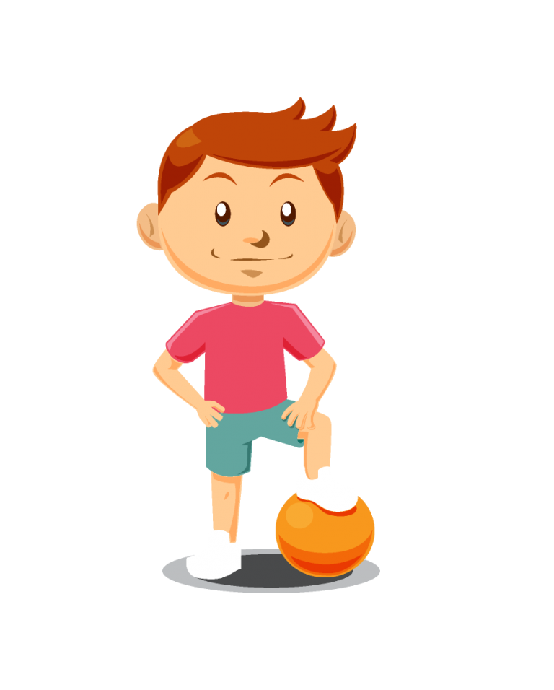

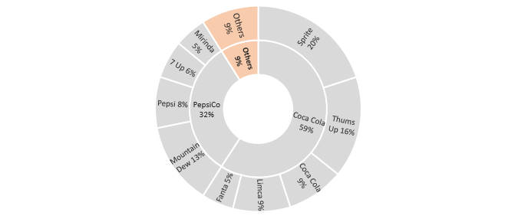
Sub-Category Evaluation
Market Estimation
Primary Research Findings
Product
Price & Place
Promotion & Timeline
Financials
Risks, Mitigation & Road Ahead
Current Market (Non-Alcoholic Beverages)
Porter’s Forces
Non-Carbonated Drinks
28430 Cr
CAGR 13.0%
Low
Mid
High
Non-Alcoholic
Threat of
New Entrants
High Cost of Entry
High Capital Requirements
Health Regulatory Requirements – FSSAI
Securing shelf life in stores can be challenging
14970 Cr
CAGR 8.4%
25%
43400 Cr, CAGR 11.5%
Carbonated Drinks
Carbonated Drinks market other than Pepsi & Coke Dominance
Bargaining Power
of Suppliers
Large number of suppliers across India
Switching Cost is low except for specialized Suppliers
Wide selection of affordable ingredients
15%
≈ ₹ 1347 Cr
Carbonated
Drinks
≈ 14970 Cr
Large retail chains constitute major sales
Secondary research indicates ≈ 15% decrease in demand for every 5% increase in price
Low switching cost for buyers, but less options
Demand Estimate for Masala Drink Market
Bargaining Power
of Buyers
10%
Total Est. Market (Volume) ≈ 16.4 Cr Litres
Large companies operating in the carbonated drinks category can launch similar products
Healthy drinks are increasingly becoming popular
Buyers are likely to switch to other alternatives
Total Est. Market (Value) ≈ ₹1387 Cr
Threat of Substitutes
20%
Rivalry among Firms
Emerging competition: Nascent market, new entrants
Innovation focus: Rivalry in flavor, packing, and marketing
Competition for shelf space
TOMA is relatively low
25%
Complementary Products
Snacks with health benefits (low fat/high protein)
Partnering with snack or dessert brands for cross-promotional campaigns can create synergy and drive sales for both products
5%
*Percentages indicate the importance in terms of weightage
Source – Netscribes Inc. Report, for demand estimation please refer attached working sheet
Masala Drink-Overall an attractive category to foray into based on market size & porter’s forces

Slide 4
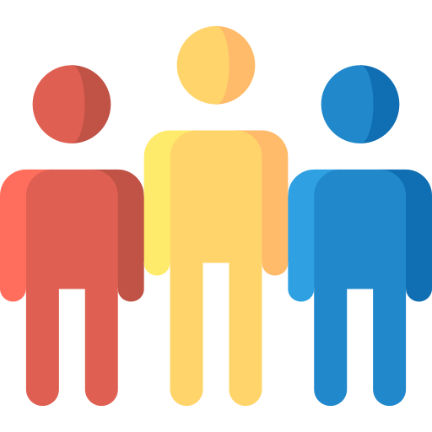



Sub-Category Evaluation
Market Estimation
Primary Research Findings
Product
Price & Place
Promotion & Timeline
Financials
Risks, Mitigation & Road Ahead
PRIMARY RESEARCH FINDINGS
Age group | Forms | In-depth Interviews | Male | Female | Total
15-20 | 15 | 5 | 12 | 8 | 20
21-30 | 25 | 5 | 20 | 10 | 30
31-40 | 20 | 5 | 15 | 10 | 25
41-60 | 5 | 5 | 5 | 5 | 10
1. 65 Google form responses focused on need arousal and taste preferences.
2. 20 in-depth interviews (40 mins each) to identify sub-category and marketing mix
Cultural Heritage – 24%
Authentic & Transparent – 16%
Perceived Refreshment – 61%
Consumers are increasingly interested in exploring and celebrating different cultures across age groups
Products that authentically represent Indian flavors and traditions
Consumers are increasingly seeking transparency in food and beverage products
Highlighting the use of genuine Indian flavors can build trust with consumers
Fizziness is often associated with a refreshing sensation
Refreshment is a multisensory experience where taste, temperature, aroma, and appearance play a role
Need Arousal – 40%
Better Alternatives – 55%
Curiosity to Explore – 36%
Tasty but not Unhealthy – 82%
Sourcing & Sustainability – 24%
Pairing while eating something -
Socializing with friends and family
Avoid motion sickness while travelling
Perception for better digestion
Thirst Quencher during summers
Soft drinks like Coke and Pepsi are preferred, but they are not the best options
Tried other alternatives but they lack appeal as well as availability
Consumers, especially younger generations, are adventurous and open to trying new and exotic flavors
Offering a masala-infused soda drink can provide a sense of novelty
Consumers are increasingly health conscious and seek products that are free from artificial additives
At the same time they want something that can satisfy their taste buds
Consumers are becoming aware of the carbon footprint associated with food and beverages
They are looking for drinks that are free from artificial additives and made with eco-friendly practices
CONSUMER PROFILING BASED ON PRIMARY RESEARCH
ACTIONABLE INSIGHTS BASED ON CONSUMER BUYING JOURNEY
Independent Adults
3
Purchase
Informed Youth
1
Awareness
22-30 age group; Aspirational & heavily influenced by social media
Moving towards a healthy lifestyle, trends like low-sugar or no-sugar
Dependence on hyper-delivery apps
Prioritize minimalistic, bright packaging for a fresh, simple, and nostalgic appeal, ensuring strong brand resonance from earlier stages
15-20 age group; Highly social, make informed decisions even in low involvement products
Can influence others through
reviews and recommendations
Awareness is fostered through relatable pre-launch buzz, product visibility on store shelves, and influencer partnerships for enhanced trust and engagement
4
Experience
Looking for a refreshing experience without feeling the guilt of unhealthy indulgence
Middle Class Family
Skeptical Grandparents
2
Consideration
5
Post Purchase
Price Conscious; Apprehensive about soft drinks
Looking for better alternatives with regional and healthy ingredients
High disposable income and trust & innate biases
Willing to purchase carbonated beverages but concerned about harmful effects
Consideration revolves around flavor profiles, the desire for both taste and healthiness, and alignment with personal values and lifestyle
Post-purchase, customers experience no guilt (common in soft drinks), find refreshment, and may become brand advocates when recalling positive interactions
The percentages are based on the responses received in Google Form and Insights obtained during In-Depth Interviews

Slide 5
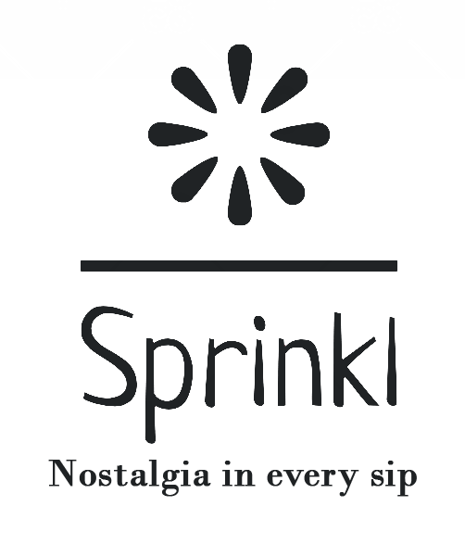
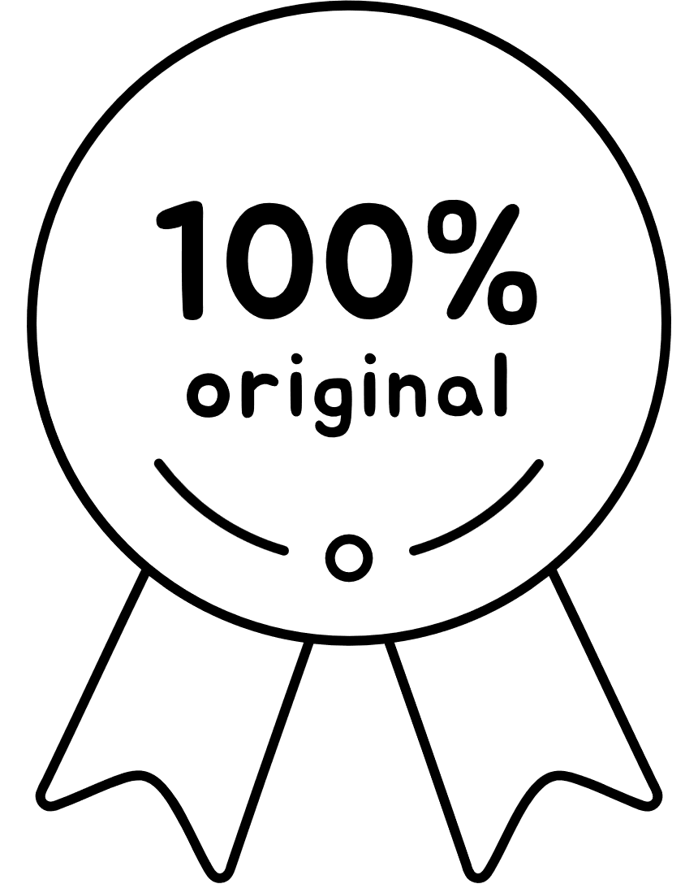
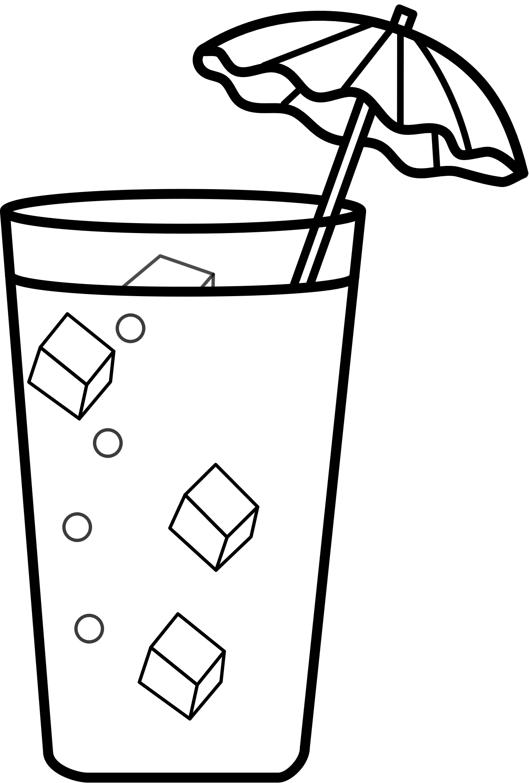
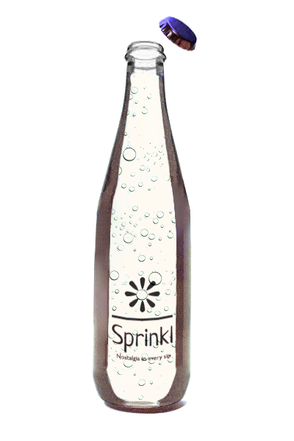
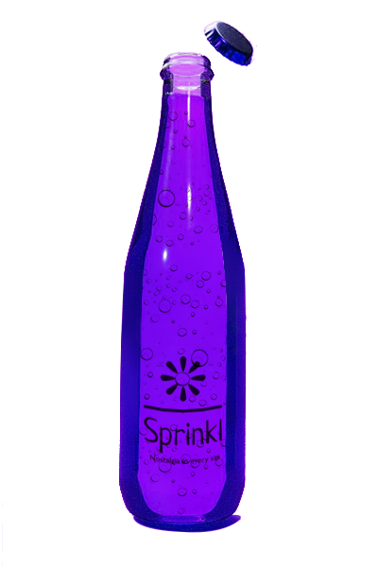
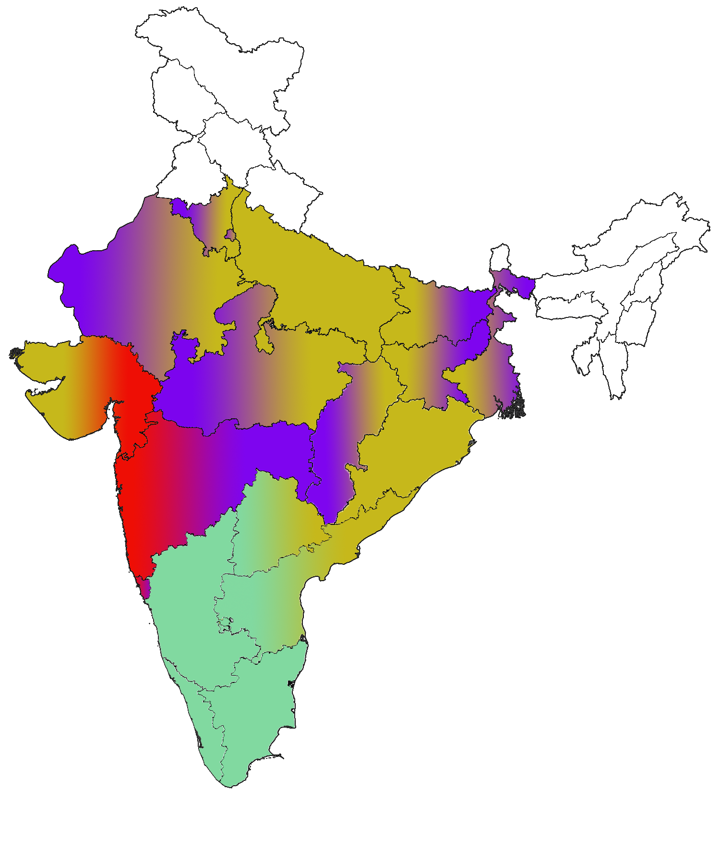
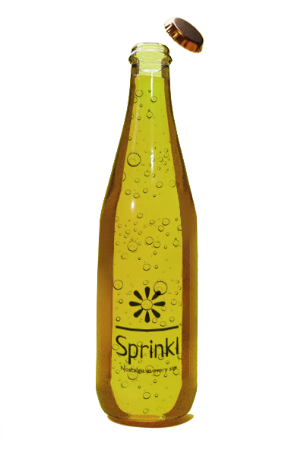
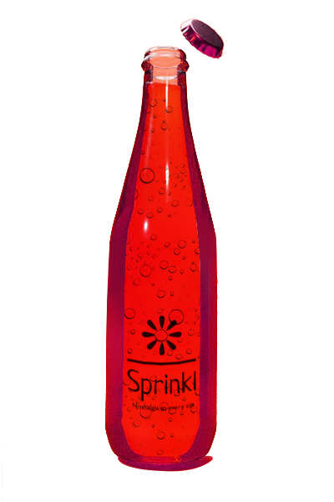


Sub-Category Evaluation
Market Estimation
Primary Research Findings
Product
Price & Place
Promotion & Timeline
Financials
Risks, Mitigation & Road Ahead
PRODUCT
PACKAGING
VALUE PROPOSITON
Recycled Plastic Bottles
Nostalgic Design
Sprinkl - A masala drink available in mouth-watering regional flavors
Our bottles are crafted from recycled plastic to resemble traditional glass cola bottles, including similar caps
The design brings nostalgia, reminiscent of regional glass bottle from the past
Authentic Regional Flavours
Minimalist Design
Sustainable Option
Embark on a flavorful journey with Sprinkl as we whisk you away to the heart of Konkan, the bustling streets of Mumbai, the serene South, and the vibrant markets of Delhi. Taste the true essence of India in every sip
A perfect blend of health and taste. Gives one 'Nostalgia in every Sip'
The bottles feature a minimalist design, appealing to young adults and promoting product reusability
Our bottles promote sustainability in daily use, reducing environmental impact
Unique Selling Proposition
FLAVOURS
Versatile Enjoyment
Delivering Refreshment Rooted in Tradition
The brand is deeply rooted in tradition, offering an authentic and timeless taste experience
Exploring Regional Taste Diversity
Showcasing unique yet familiar flavours like Kokum, Shikanji, Kaala Khatta, and Coconut, celebrating India’s regional diversity
Whether you're sipping Sprinkl at a family gathering, quenching your thirst on a scorching summer day, or pairing it with your favorite snacks, our carbonated masala drinks are the perfect companion for any occasion
Coconut
Chiller
Kala Khatta
Crush
Healthier Indulgence
Emotional Selling Point
Our carbonated masala drinks are made with natural ingredients and no artificial colors. Plus, they are enriched with the goodness of regional spices and herbs that have been celebrated for their health benefits for centuries
Cultural Heritage and Authenticity
The cultural heritage and authenticity of traditional recipes promise India's rich traditions in every sip
Unique Flavour Exploration
This ESP promises a unique flavor journey, encompassing India's diverse culture in each bubble
Tradition & Innovation
The drinks blend tradition and innovation with time-honored recipes for a contemporary beverage adventure
Nimbu
Shikanji
Kokam
Delight
Our primary target markets for Masala Drinks are central, west, and south India based on our Interviews and market research. The east and north regions have shown less interest due to colder climates, so we're initially focusing on areas with higher market potential. Future expansion may include tailored products for these regions
Meticulous Craftsmanship
Each bottle of Sprinkl is meticulously prepared with the finest ingredients, ensuring the perfect balance of flavors, fizz, and spices. Our commitment to quality delivers a consistently delightful taste every time
Coconut Chiller
Nimbu Shikanji
Kala Khatta Crush
Kokam Delight
Each of the flavours are chosen to primarily cater to regional preferences while also providing other options

Slide 6
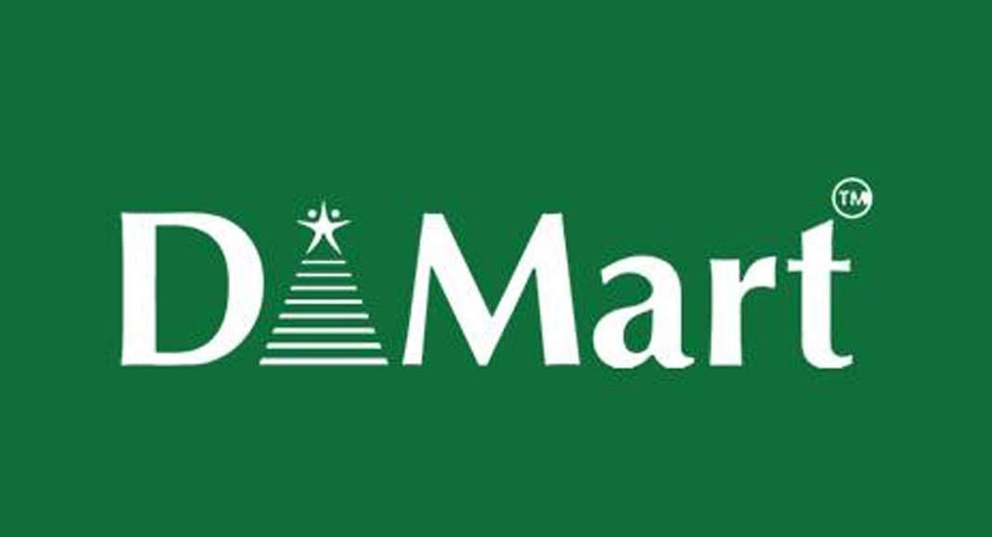
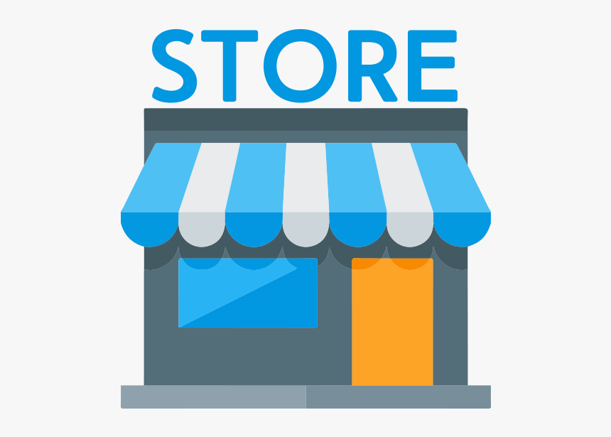
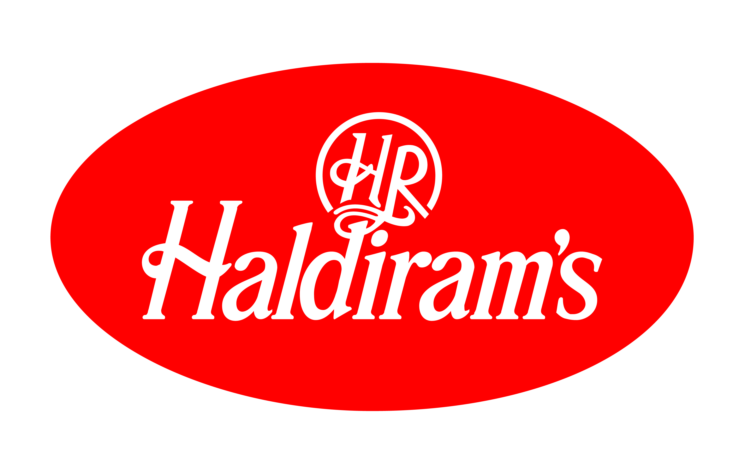

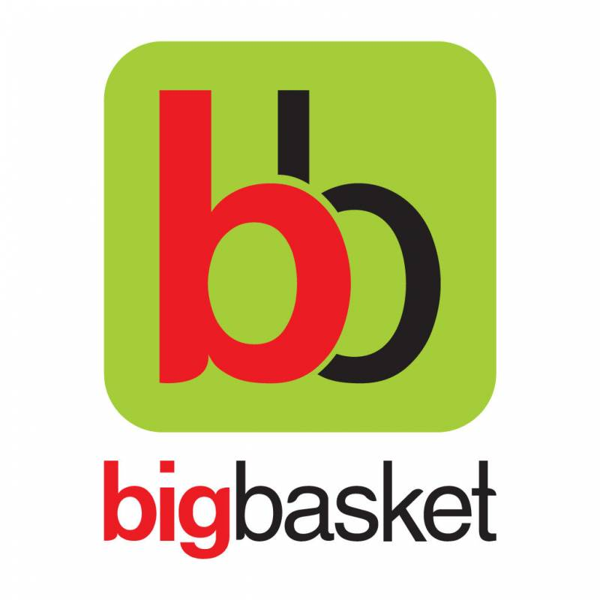

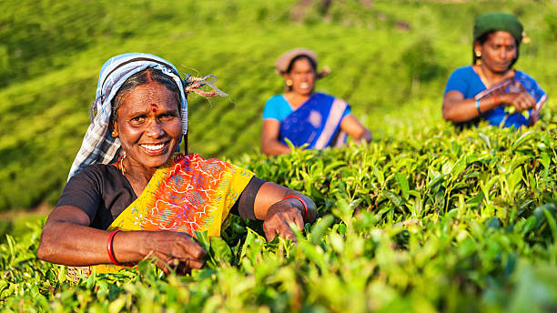
Sub-Category Evaluation
Market Estimation
Primary Research Findings
Product
Price & Place
Promotion & Timeline
Financials
Risks, Mitigation & Road Ahead
PRICE
Rationale
The product is new and the market is underpenetrated to a certain extent but consumers over a period have developed a habit to pay ₹ 20 for 200 ml and 600 ml for ₹ 40 and so on
This is mainly because of the domination of Coke and Pepsi and also the denomination factor coming into the picture. In our In-depth interviews, we asked consumers whether they were willing to pay less or more for a 200 ml bottle but 80% of them said no
Rather than going for any differentiated pricing we will launch Sprinkl in a competitor based pricing model which will be dynamic in nature
PLACE
Distribution Channels
Demand Based
Competition Based
Traditional Channels
Partnerships
E-Commerce
Premium Pricing
Ensure availability in diverse retail outlets like supermarkets, convenience stores, hypermarkets, and local grocery stores for widespread access
2. Attractive in-store displays and promotions for visibility
3. Leverage ITC’s existing distribution network
1. Collaborations with businesses such as airlines(In-flight meal) and fast-food chains will enable us to expand our market reach beyond retail
2. Co-branded promotions enhance brand visibility
3. Stringent quality control for partner satisfaction
1. Availability on all the major e-commerce platforms
2. Digital marketing and targeted advertising efforts will drive online visibility and attract consumers to our Masala Drinks
3. Integration with hyper-local delivery platforms will enable us to offer quick, doorstep delivery
PRICE MIX
Free Sampling
In a country where every rupee counts, the allure of free sampling is an irresistible treasure. Sprinkl understands the discerning Indian consumer, always on the lookout for value and eager to explore new tastes without breaking the bank
4 SKU’s per flavor
Total 4*4- 16 SKUs
SOURCING O
Sprinkl will source ingredients from local farmers who have tilled the land for generations. It's more than just business; it's a partnership built on trust, respect, and shared values
Our commitment to ethical sourcing ensures that these hardworking farmers receive fair compensation for their labor and dedication
By sourcing ingredients locally, we not only promote ethical practices but also preserve the authenticity of India's diverse flavors
Key Accounts
Price Premium
Bundling
The Point of Sales material would be different for Key accounts and critical retail stores from the normal retailers to boost penetration across regions
The partnership will help ITC to charge a premium for the masala drink. Also, this will open up new avenues for customer acquisition over and above the traditional channel
Sprinkl can be bundled with frequently bought munchies and beverages. Bundling will ensure an increase in awareness as well as penetration at the initial stage of the product launch
Ethical sourcing from Indian farmers
Company logos shown are only for example purposes

Slide 7
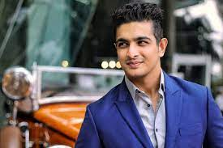

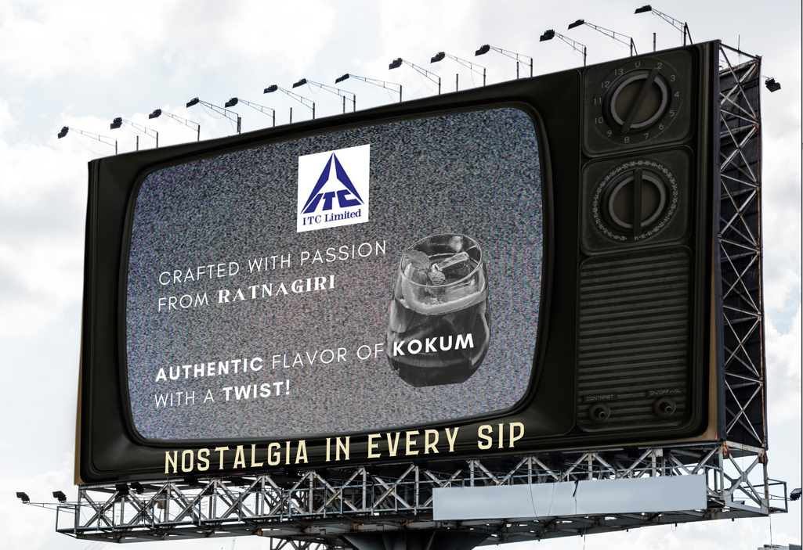

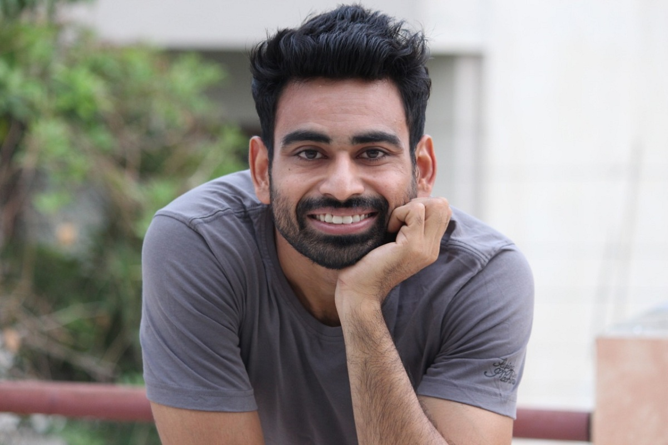
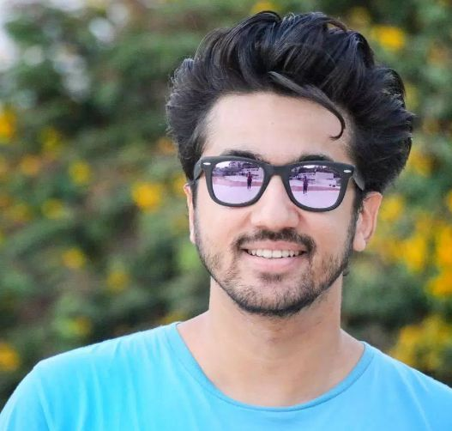


Sub-Category Evaluation
Market Estimation
Primary Research Findings
Product
Price & Place
Promotion & Timeline
Financials
Risks, Mitigation & Road Ahead
Out of Home Advertising
Pre Launch
Influencer Collaboration
Hoardings Campaign
Bus Shelters
Teaser Phase
The campaign theme is "Nostalgia in Every Sip" celebrating regional flavors with a touch of nostalgia
Hoardings will feature a vintage-style TV display with the Sprinkl logo and a refreshing glass of the drink along with sourcing from – ‘Region Name’
Bus shelters will display captivating visuals highlighting regional spices and ingredients, providing an engaging and informative experience for commuters
The central part of the shelter would be covered by the theme ‘Nostalgia in every Sip’
Influencer Teasers: Each of the chosen influencers will post a series of teaser videos on their respective social media platforms, creating curiosity about the upcoming masala drink. They can hint at its regional origins and the spice blend without revealing details
Mystery Masala drink Box Giveaway: Collaborate with the influencers to host a giveaway where participants have a chance to win a "Mystery Masala drink Box" containing a selection of authentic spices from the drink's region of origin. Participants must follow Sprinkl brand's social media handle, like the influencers' posts, and share their excitement using #Nostalgiaineverysip hashtag
Ranveer Allahabadia
2.7 M Followers
Location Planning
Location Planning
6 M Subscribers
Tier 1 Cities
Tier 2 Cities
Lifestyle & Motivation
Delhi-NCR-Connaught Place entrances, Nehru Place IT Hub
Mumbai-BKC, Andheri Link Road
Bangalore-MG Road, Brigade Road
Kolkata-Park Street, Esplanade, and Salt Lake City
Chennai-Mount Road & Nungambakkam
Jaipur- MI Road, Raja Park, and JLN Marg
Lucknow-Hazratganj, Gomti Nagar, and Charbagh
Coimbatore-RS Puram, and Avinashi Road
Bhubaneswar-Master Canteen, KIIT Square, and Patia
Indore -MG Road, Vijay Nagar, and Palasia
Exploration Phase
Spice Journey Webisodes: Partner with the influencers to create a series of YouTube videos that delve into the journey of sourcing and blending the authentic spices used in Sprinkl masala drink
Interactive Social Challenges: Encourage followers to participate in spice-related challenges inspired by the videos. For example, they can share their own spice market experiences, spice blending attempts, or favorite spice-infused recipes. Offer prizes for the most creative and engaging entries
Fittuber
295k Followers
Rationale
7.3 M Subscribers
In primary research, we found that the trust & engagement for influencers is higher than celebrities, a pre-launch campaign with influencers will increase the hype for the drink
Fitness & Wellness
Rationale
Rationale
Virtual Launch
Hoardings would be more effective in Tier 1 cities at strategic locations. This is based on our primary research where 60% of people from Tier 1 cities selected hoardings as the preferred medium of awareness for new products & nostalgic theme of the hoarding will make viewers curious about the drink.
Bus shelters offer a unique advantage in tier 2 cities as it is the most popular mode of transport among the lower middle class. Also, the recent penetration of many advertising agencies in tier 2 cities offers a great opportunity for an innovative execution of the campaign.
Mumbiker Nikhil
Launch
1.4 M Followers
Grand Virtual Launch Event: Host a grand virtual launch event featuring all three influencers. This event should include the official unveiling Sprinkl masala drink and a deep dive into its regional flavors. Incorporating regional live bands can increase engagement
4 M Subscribers
Lifestyle & Travel
City wise location planning is based on Secondary Research
Influencers are chosen based on Primary Insights and current popularity. These collaborations would target younger age group

Slide 8
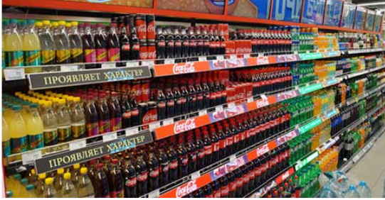
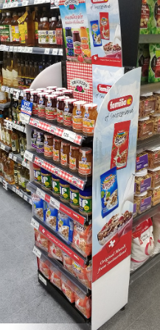

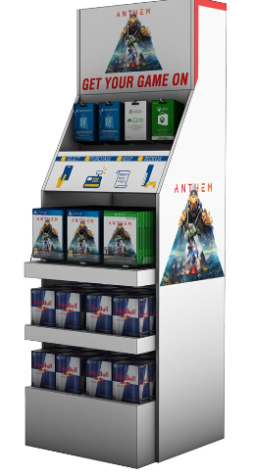

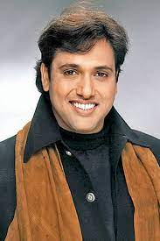
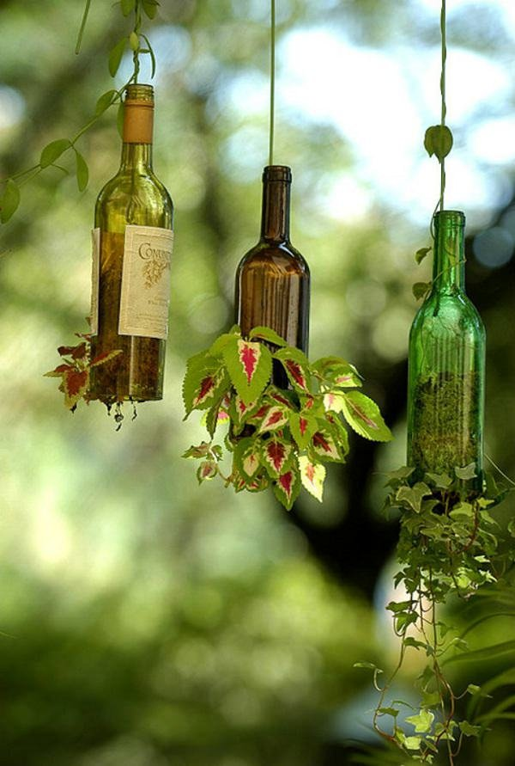
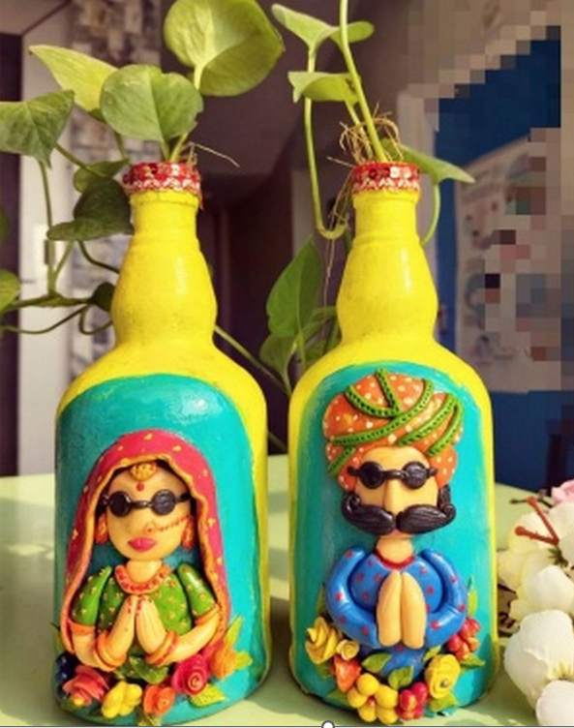
Sub-Category Evaluation
Market Estimation
Primary Research Findings
Product
Price & Place
Promotion & Timeline
Financials
Risks, Mitigation & Road Ahead
Post Launch
SPRINKLRS - Community Engagement
Point of Sales Material
The Big Idea
Shelf Talkers
Floor Stands
Retail POS Importance
A QR code will be present on each of the bottles. Once the consumer scans the code he/she gets a point and is added to that particular bottle color’s community for example by scanning the Nimbu Shikanji bottle the consumer will be added to the SPRINKLRS- White club and so on for other colors
Once a consumer scans a certain number of bottles he/she added to the community page of SPRINKLRS, the motive is to build a new use-case of community engagement in addition to the functional benefits of the drink
Mass market purchase decisions are made in retail stores, Retail POS is low-cost and highly effective, especially in the beverages industry
Customers tend to make impulse purchases when they visit retail stores so the importance increases manyfold
The different colors of Sprinkl can also be utilized to make POSM more engaging and innovative
Counter Displays
Advantages
Cross- Selling
Masala drink is not as frequently consumed as soft drinks, so community engagement can increase consumption as rewards can be linked on a weekly/monthly basis making it a differentiating factor
Community-driven engagement offers an opportunity to cross-sell other ITC products in the food and beverage portfolio, and if the idea is well received by consumers then this can help create an economic moat in the low-involvement product industry for ITC
T.V. Commercial
SPRINKLRS - Sustainability Challenge
The Big Idea
Brand Ambassador
Rationale
Bottle Art Competition
Bottle Collection Stories
The Retro theme of Sprinkl + the authentic masala flavors resonate with Govinda. Moreover, the idea of TVC is to gain the attention of TG in the elder age bracket of 35+
The economic cost of making a bottle 100% eco-friendly is not really possible as it will increase the total cost. India is price-sensitive in this category, but different use cases can be built for these bottles so that they can used after consumption. Décor is one such category that can be leveraged along with a user-generated campaign driving the focus towards sustainability which is the ethos of ITC
DIY Bottle Crafts
Bottle Photography Challenge
Sample entries on social media handles of Sprinkl
Script of TVC
Cut to Govinda, in his signature dance style, amidst the market chaos
Introducing Sprinkl Masala Drink! Four flavors, one masala sensation
It's not just a drink; it's nostalgia in every sip, bringing back the memories of our roots!
The entries submitted by users on social media with hashtags associated with Sprinkl will promote the drink as well as different use cases for the bottle. Eventually, high engagement will convert consumers into promoters.
GOVINDA
TVC will be broadcasted on channels wherein the Target Audience would be in the Age group of 35+

Slide 9
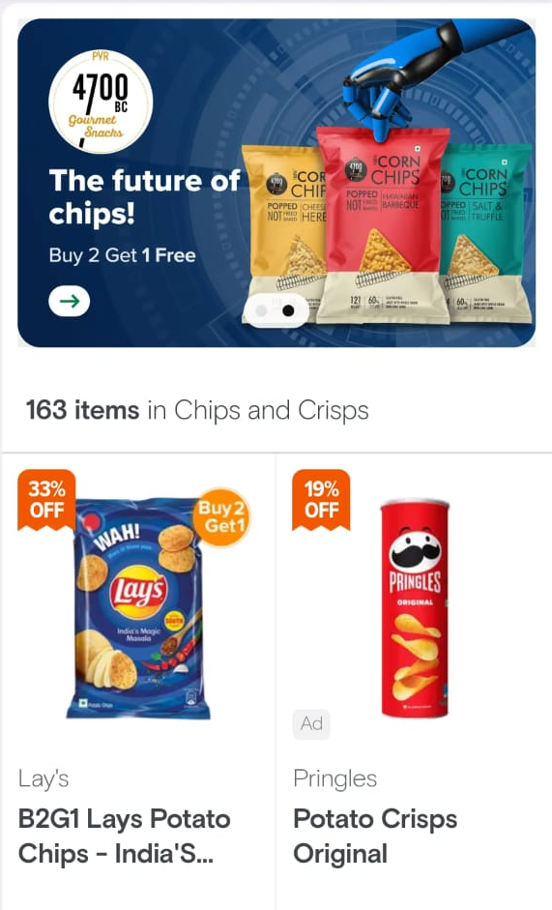
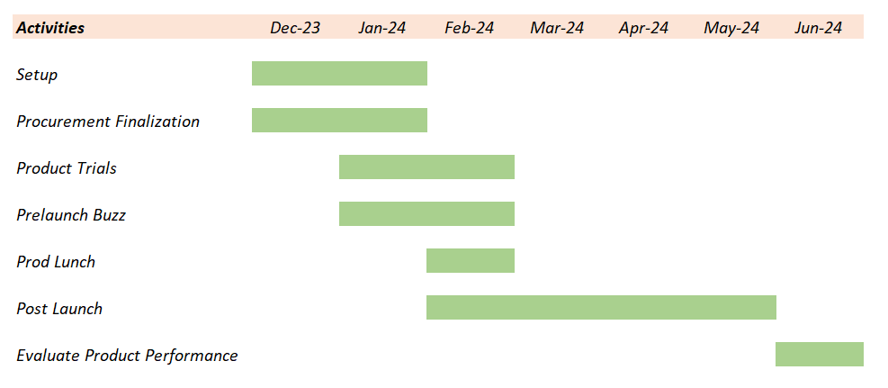
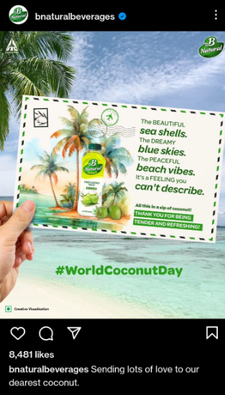
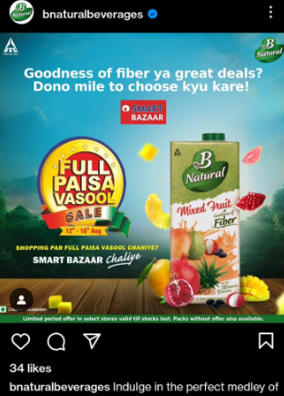
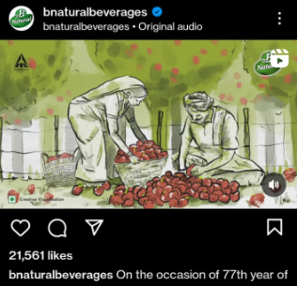
Sub-Category Evaluation
Market Estimation
Primary Research Findings
Product
Price & Place
Promotion & Timeline
Financials
Risks, Mitigation & Road Ahead
ONLINE MARKETING
E-Commerce Platform
PROJECT TIMELINE
Social Media Engagement
PROPOSED STEPS
Secure suppliers, materials, and production agreements
Conduct Pre-Launch buzz activities in public places and via social media campaigns
Run user-generated campaigns focused on sustainability, digital marketing campaigns, and community-based engagement
Enhanced Visibility: Initially, masala soda ads can be positioned at the top to increase the rate of purchases
Brand Awareness: We can also promote our brand 'Sprinkl' on popular e-commerce platforms
Product Ratings: The Product showing on the top would also mean more ratings which in turn would drive more people to choose our product
B-Natural Analysis
Content related to nature, reality, and the creative process receives ≈250 times more interactions than content focused solely on product and pricing
User Generated Content
Users visit different places and post photos tagging ITC’s “Sprinkl” that reminds them of our flavours, increasing organic traffic and engagement with more relatable content
Conduct quality tests and ‘Product Tasting’ events
Launch the Product at the beginning of Summer Season
The launch of Sprinkl may enhance ITC’s digital outreach

Slide 10
Sub-Category Evaluation
Market Estimation
Primary Research Findings
Product
Price & Place
Promotion & Timeline
Financials
Risks, Mitigation & Road Ahead
FINANCIALS
Break Even Analysis
*Note - Please refer attached file for Financials
Break Even Point will be reached during October 2024
Variable Cost
Traditional Media (35.6%)
Outdoor Media (31.6%)
Print Media
(14.0%)
Total Other
Expenses (18.7%)
Expense incurred while advertising through Traditional Media Channels
Expense incurred while advertising through Billboards & Bus-stands
Expense incurred while advertising through Newspapers, Pamphlets & Flyers
Other Expenses – 8.6%
Influencer Partnerships – 4.9%
Digital Marketing – 1.8%
Point of Sales Costs – 1.3%
Celebrity Partnerships – 1.3%
Campaign Costs – 0.9%
Kindly refer attached sheet for detailed calculations

Slide 11

Sub-Category Evaluation
Market Estimation
Primary Research Findings
Product
Price & Place
Promotion & Timeline
Financials
Risks, Mitigation & Road Ahead
Risk Handling
Process
STEP 1
Identify all events in which risks are possible
STEP 2
Risk assessments based on source, process & controls
STEP 3
Prioritized risk mitigation strategy formulation
STEP 4
Implementing strategy and monitoring progress
Future Roadmap
Collector Series
RISK
MITIGATION
RISK
MITIGATION
Jan’27
Introduce limited-edition regional flavors with packaging inspired by renowned Indian artists and cultural icons. E.g. Rewards will be given on certain collections
Extensive marketing and sampling campaigns to educate and create awareness
Inconsistent Flavour Quality
Implement stringent quality control, conduct regular product testing for consistency
Consumer Awareness
Apr’26
Establish a strong regional presence by focusing on local flavors. Develop regional marketing strategies by
leveraging distribution network
Develop region-specific production and scaling plans that align with unique demand patterns and preferences. E.g. Kokam (Maharashtra) Shikanji (North)
Offer personalized drink options with regional flavors, including seasonal choices for festivals and seasons
New, seasonal and customisable flavours
Regional Competition and Fragmentation
Scalability Across Regions
Develop an integrated supply chain network that includes local sourcing of spices and ingredients to reduce costs and ensure a steady supply
Implement robust anti-counterfeiting measures, including unique packaging, holograms,
and QR code verification, to protect the authenticity of products
Supply Chain Integration
Counterfeit Products
Dec’25
100% Eco-
Friendly Packing
Apr’25
Potential Product Replication
Create flavours which are difficult to replicate. Secure Intellectual Property Rights (IPR) for proprietary recipes
Invest in techniques to extend the shelf life of ingredients. Plan production schedules to align with peak ingredient availability
Health Conscious Variants
Seasonal Variations
Choose eco-friendly packaging, such as biodegradable bottles, and showcase ITC's environmental commitment on labels
Develop low-sugar or sugar-free variants using natural sweeteners for health-conscious consumers
Leverage ITC’s distribution network and push the product via brick-and-mortar channels
Maintain diversified supplier relationships across regions to ensure a steady and reliable ingredient supply chain
Shelf Space Rejection
Procurement Shortage

Slide 12
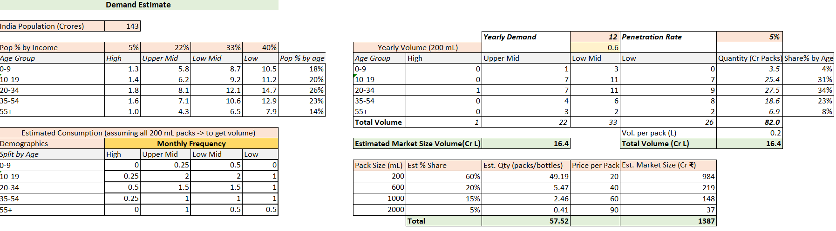
Appendix
Demand Estimate

Slide 13
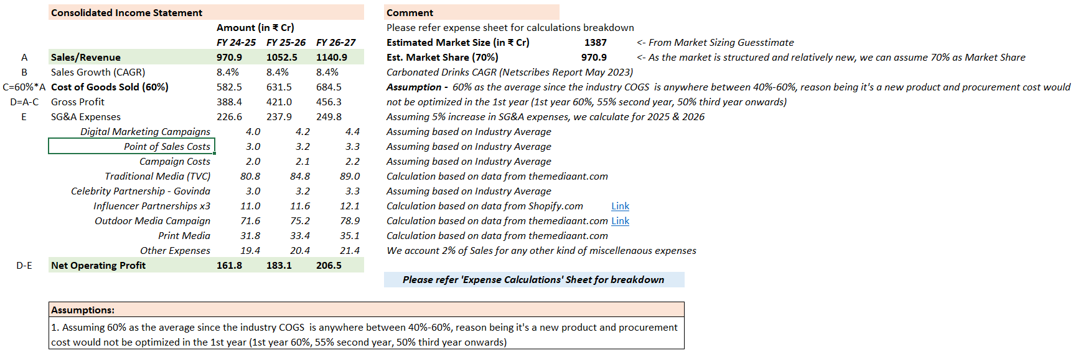
Appendix
Income Statement

Slide 14
Appendix
Break Even Analysis

Slide 15


Appendix
Expenses Breakdown

Slide 16
Appendix
Primary Research Insights

Slide 17



